Slide 1

MCM
تنفيذ مركز الاتصال- وثيقة التدريب

Slide 2
جدول أعمال
IVR Flow
Finesse Agent Screens
Finesse Supervisor Screens
End user Configuration
CUIC Reports

Slide 3
IVR تدفق

Slide 4
الرقم المجاني
The toll-free numbers provided are
8008884
8008885
While caller calls these toll free number Call will be transferred to IVR then it will be redirected to Agent based on his availability.

Slide 5
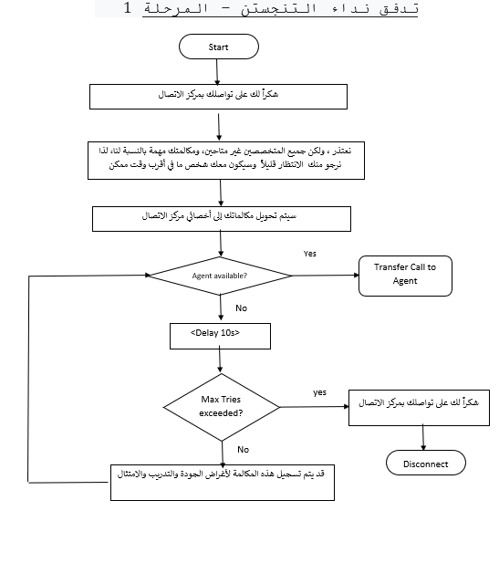
IVR تدفق

Slide 6
شاشات الوكيل البارعة

Slide 7
شاشات الجودة
Agent Login
Agent- My History
Agent - My statistics
Change status–Ready , not ready
Make calls
Agent Logout

Slide 8
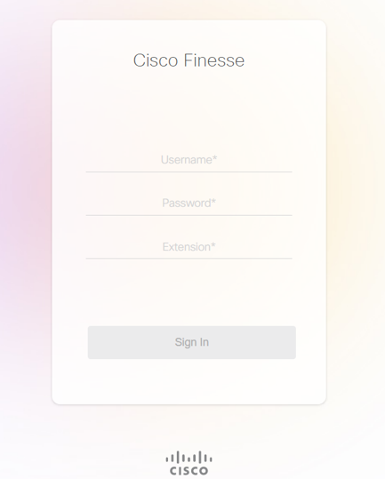
براعة تسجيل الدخول
Agent / Supervisor can Login to Finesse Desktop by providing the finesse Desktop URL by providing username, password and Extension

Slide 9
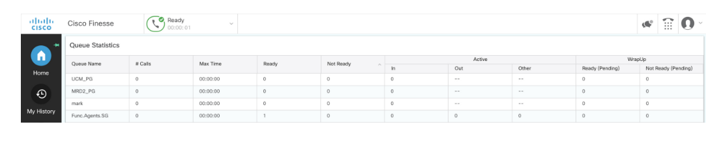
شاشة الوكيل البارعة
Following is the initial screen when agent logs in. The initial status is “Not Ready”

Slide 10
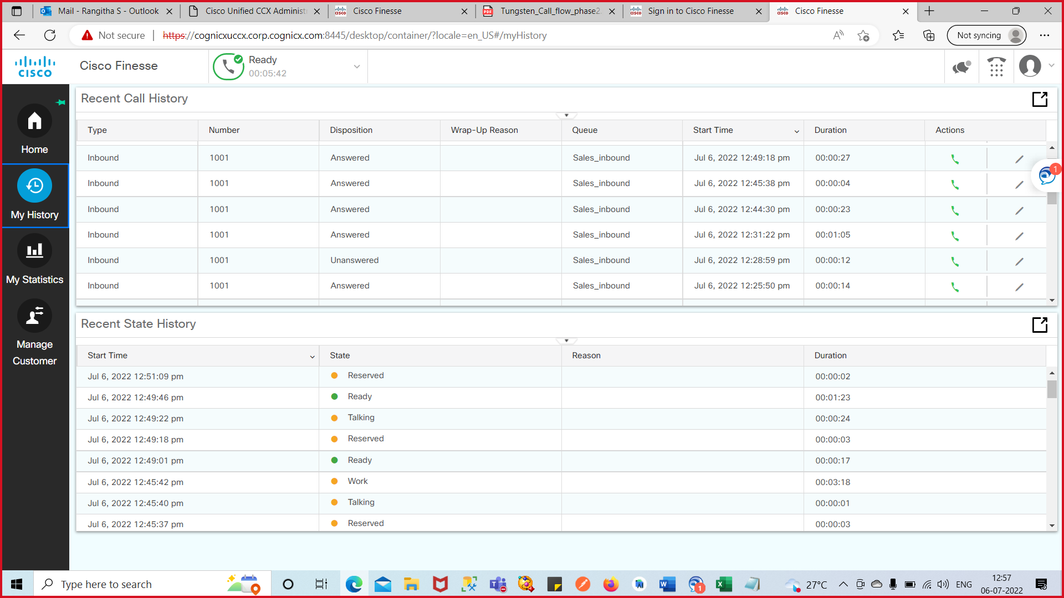
شاشة الوكيل البارعة - تاريخي
The My History screen has two parts:
Recent Call History [ list all incoming and outgoing calls since midnight]
Recent State History [list all your state changes since midnight]

Slide 11
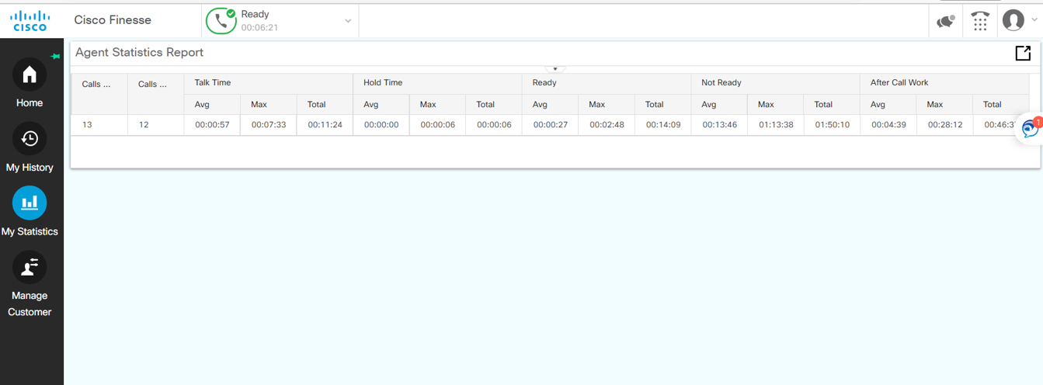
شاشة الوكيل البارعة - إحصائياتي
My Statistics provides data on your agent telephone line since midnight

Slide 12
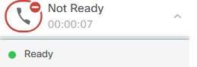
الدول المتغيرة في البراعة
Agents manage their Ready (available for calls) and Not Ready (unavailable for calls) states
Note:
Supervisors can change agent state remotely
Ready
To accept incoming calls, select Ready from the Agent State drop-down
Reserved, Talking, and Wrap-Up
These are automatic state changes. Reserved is only active when the agent is receiving a call from the queue

Slide 13
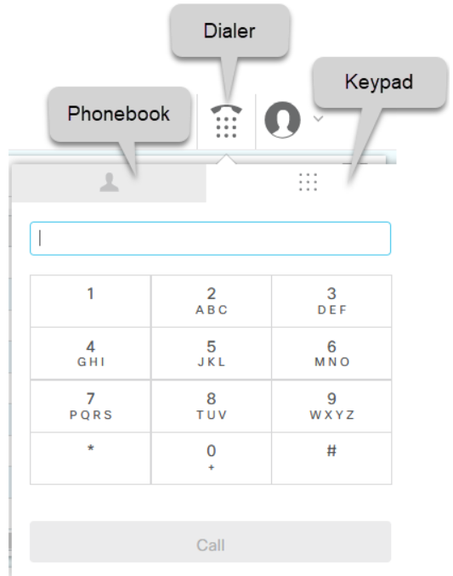
إجراء المكالمات ببراعة
By using Finesse for your outgoing calls, you will have access to your team's phonebook.
You can dial by manual entry or the phonebook.
For both methods, you will need to select the Dialer icon from the top row.

Slide 14
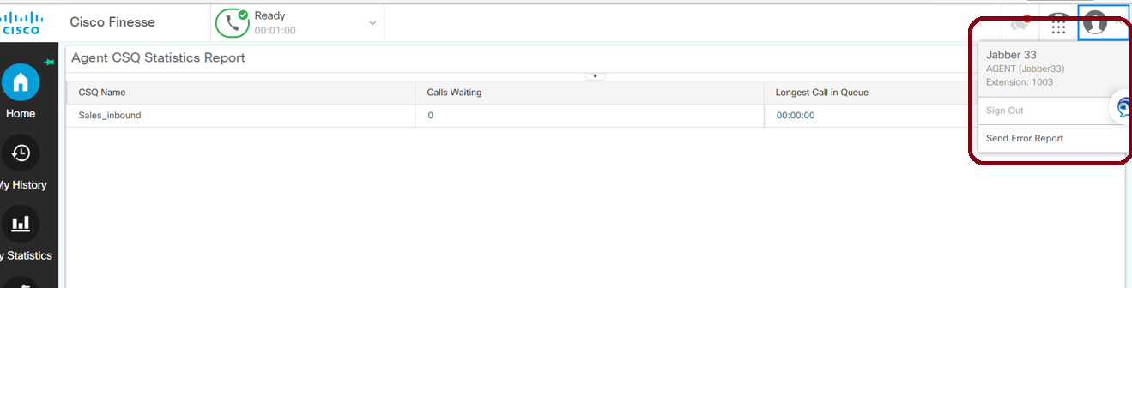
براعة الخروج
Make your self not ready
Go to the identity icon in the right corner of the Finesse Desktop and choose sign out.

Slide 15
شاشات مشرف الجودة

Slide 16
شاشات مشرف الجودة
Supervisor Login
Supervisor – Manage Team
Supervisor - My History
Supervisor - Queue Data
Supervisor – Team Data

Slide 17
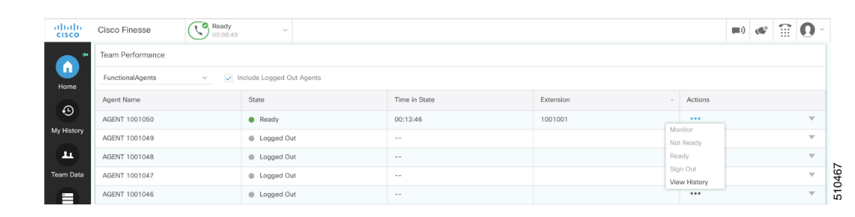
دخول المشرف
Supervisor can Login to Finesse Desktop by providing the finesse Desktop URL and his supervisor Credentials
Below are the different gadgets available for a Supervisor
Manage Team
My History
Team Data
Queue Data

Slide 18
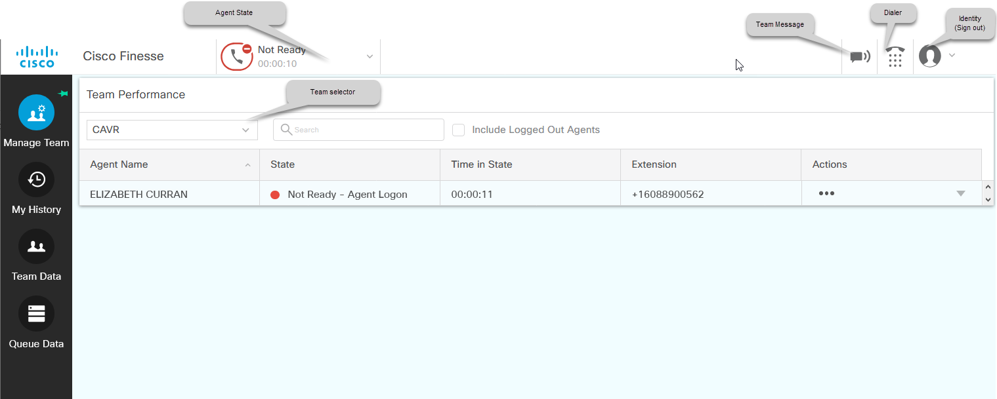
مشرف – إدارة الفريق
Supervisor can able to view/monitor the Agents State (Ready, not ready, talking along with the time state).
Note: If they want to view the details of the LOGGED-OUT agents then they can select the INCLUDE LOGGED OUT AGENTS checkbox
They can view their desktop by selecting the START MONITORING button.

Slide 19
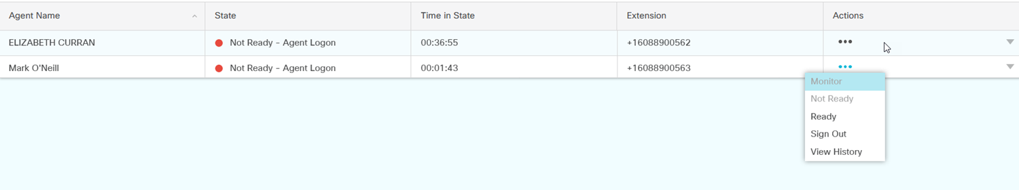
مشرف – إدارة الفريق (تابع ..)
3. They can also see all the call history and login history in the below sections.
4. The Supervisor can also make calls using the dial pad that is displayed in the screen.
5. The supervisor will also have the option to select specific contacts from the pre-defined list and dial their number.
6. To Change the status of the agent Go to the Actions column and click the three dots on the appropriate agent. Select the desired action. The available actions will vary depending on the state of the agents.

Slide 20
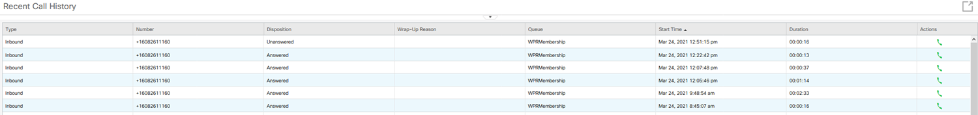
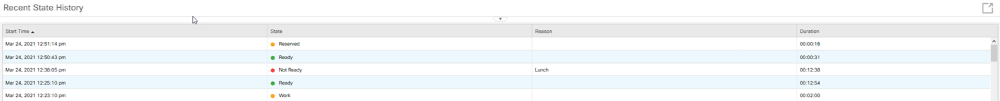
مشرف – تاريخي
The My History screen has two parts:
Recent Call History [list all incoming and outgoing calls since midnight]
Recent State History [The Recent State History will list all your state changes since midnight.]

Slide 21
مشرف – علامة تبويب بيانات قائمة الانتظار
To get the voice CSQ Summary Report, click the Queue Data icon from the left navigation in Finesse. The report will show data from midnight on that day.
Supervisor can view the CSQ status Like
Call waiting in queue
Agent logged in to that CSQ
Agent status (Ready, not ready, Break)

Slide 22
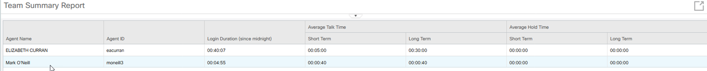
مشرف - بيانات الفريق
To get to the Team Summary Report, click the Team Data icon from the left navigation in Finesse.
The report will show data from midnight on that day. This is a real-time report that will refresh every few seconds.

Slide 23
رائع URL عنوان
URL Format- https://<FQDN>:<PORT NUMBER>/ desktop or cfadmin
Admin URL - https://<cognicxuccx.corp.cognicx.com>:<8445>/cfadmin
Desktop URL and Supervisor URL - https://<cognicxuccx.corp.cognicx.com>:<8445>/desktop
Note:
Above are sample URLS[ FQDN name should be replaced with actual UCCX server FQDN (hostname + Domain name)]
Agent and supervisor can login to Desktop by providing their credentials.

Slide 24
تكوين المستخدم النهائي

Slide 25
تكوين المستخدم النهائي
Configurations in CUCM
Phone configuration
End user configuration
Configuration in UCCX
3. Skill configuration
4. CSQ configuration

Slide 26
CUCM تكوين المستخدم النهائي -

Slide 27
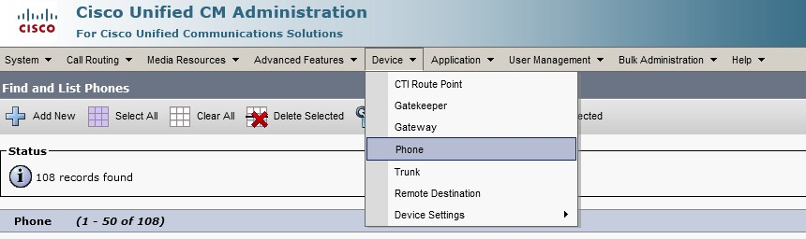
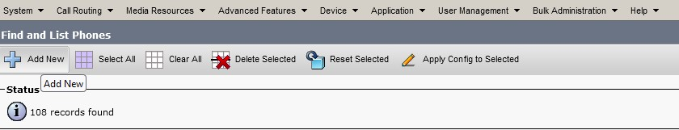
تسجيل الهاتف وإنشاء المستخدم النهائي
Login to CUCM
Go to Device→ Phone
Press Add New

Slide 28
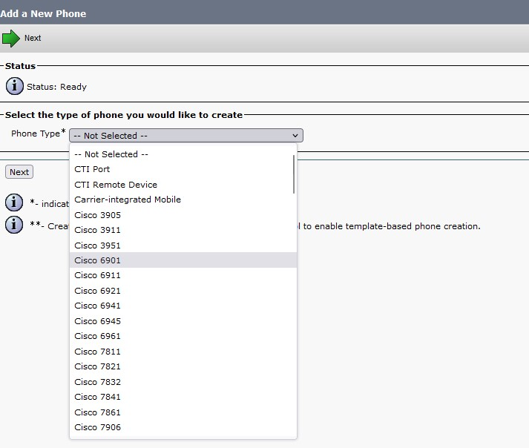
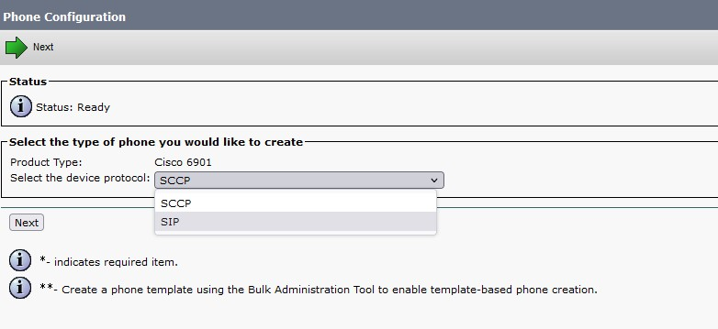
تكوين الهاتف - إضافة هاتف جديد
Choose phone type and Protocol based on IP Phone

Slide 29
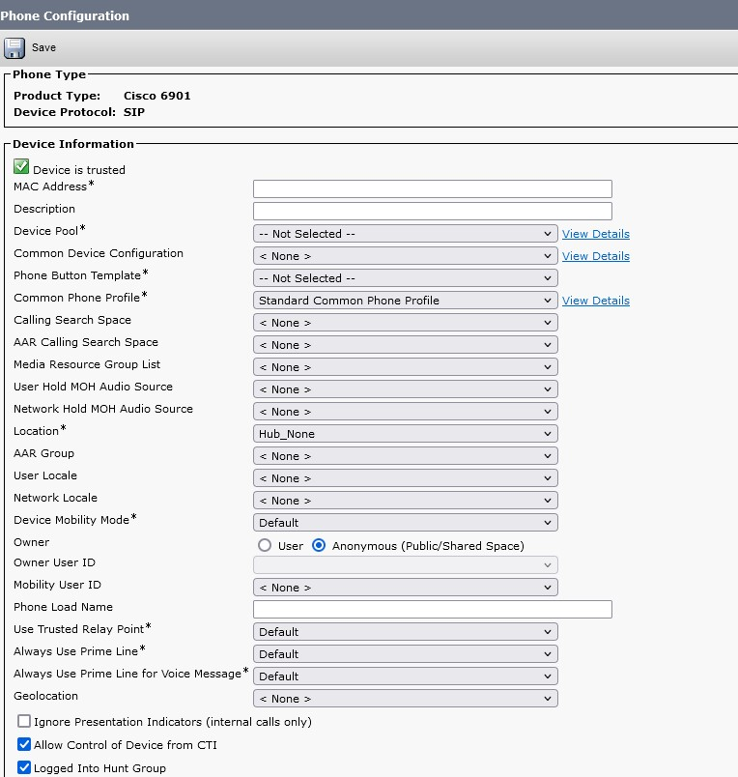
تكوين الهاتف
Following parameters are mandatory
Phone Device pool
Phone button template
Common phone profile
Device Security profile
Note: Choose Anonymous as Owner

Slide 30
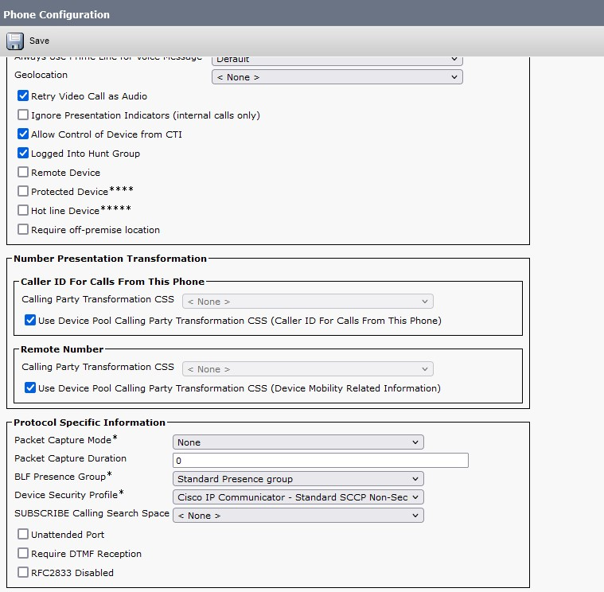
تكوين الهاتف

Slide 31
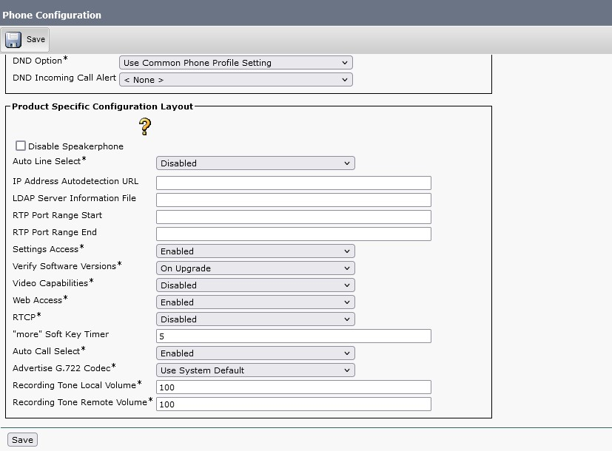
تكوين الهاتف
Click on Save and Apply config

Slide 32
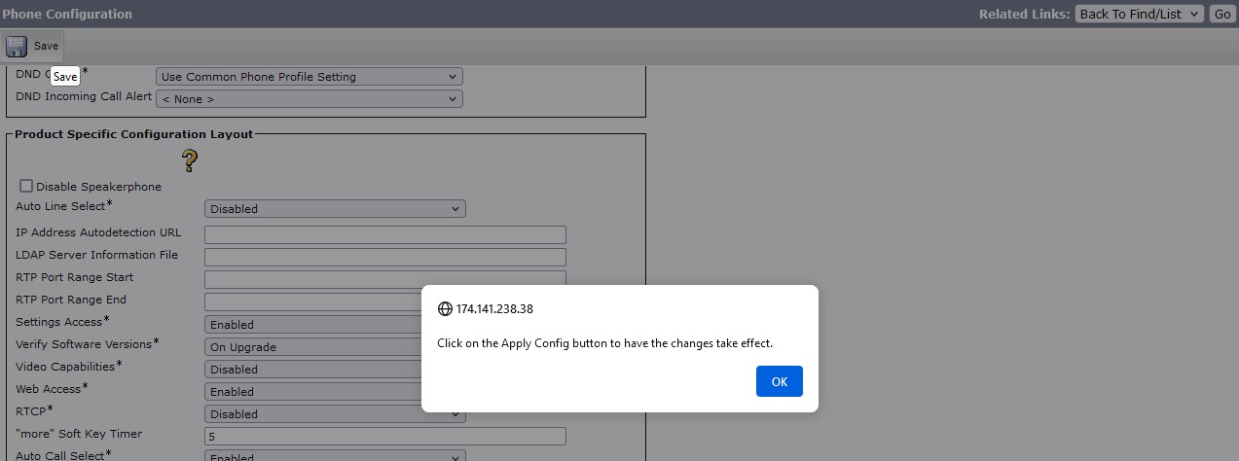
تكوين الهاتف

Slide 33
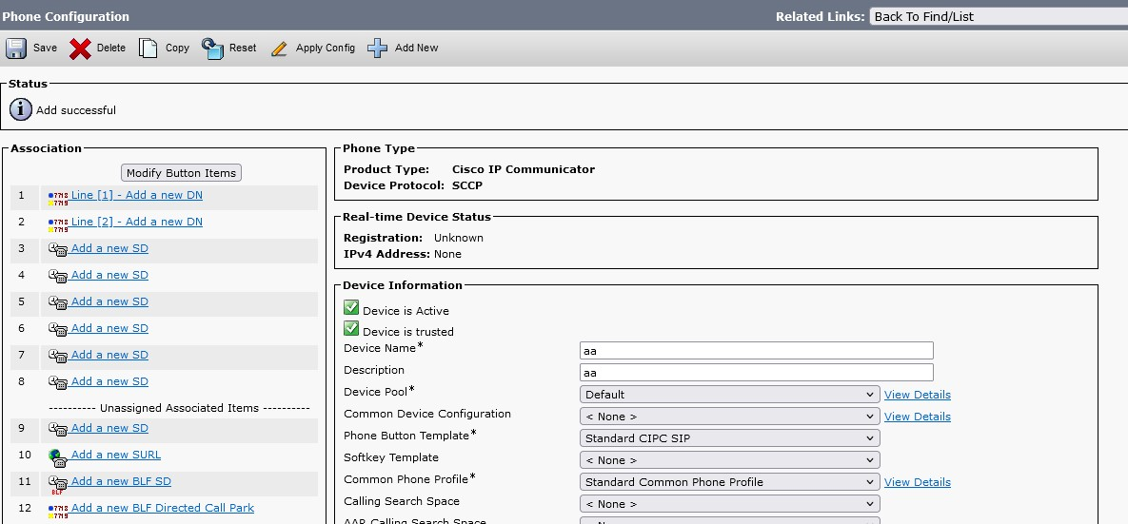
إضافة رقم الدليل
Click on ‘Add a new DN’

Slide 34
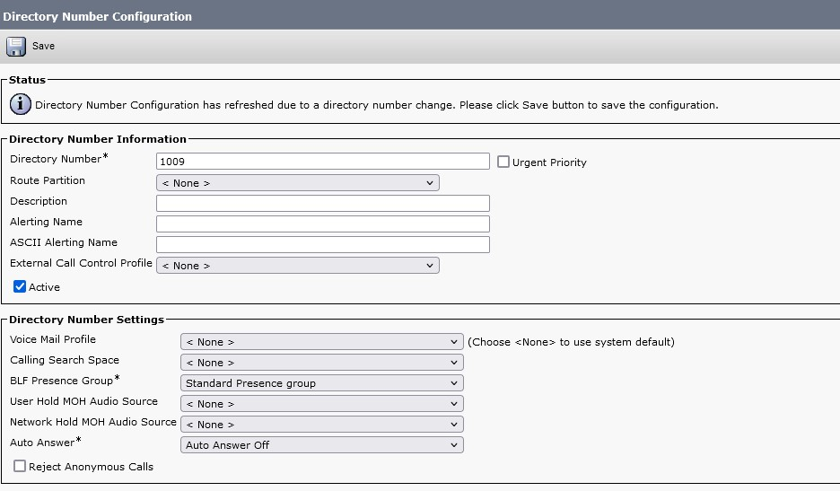
إضافة رقم الدليل

Slide 35
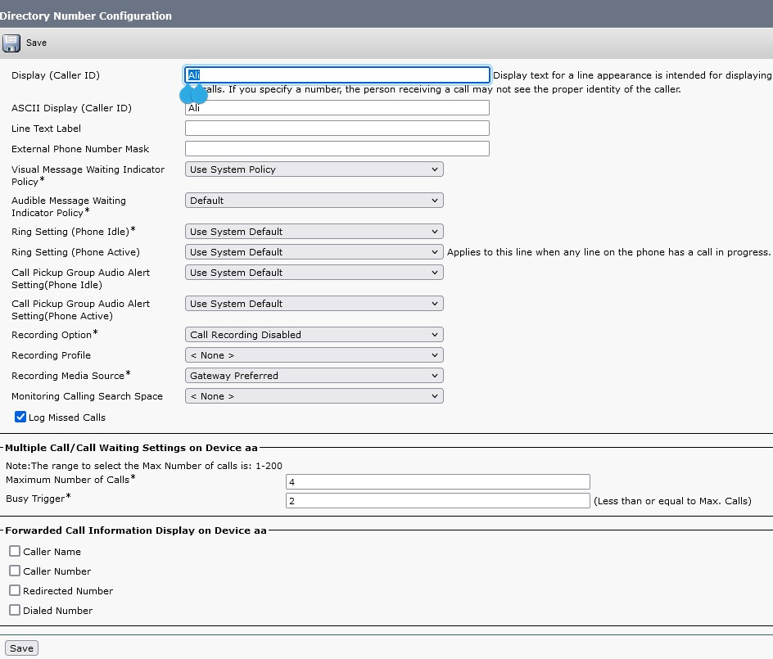
إضافة رقم الدليل
Click save once enter the directory number and display name

Slide 36
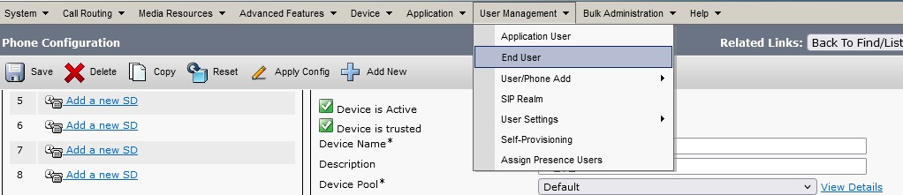
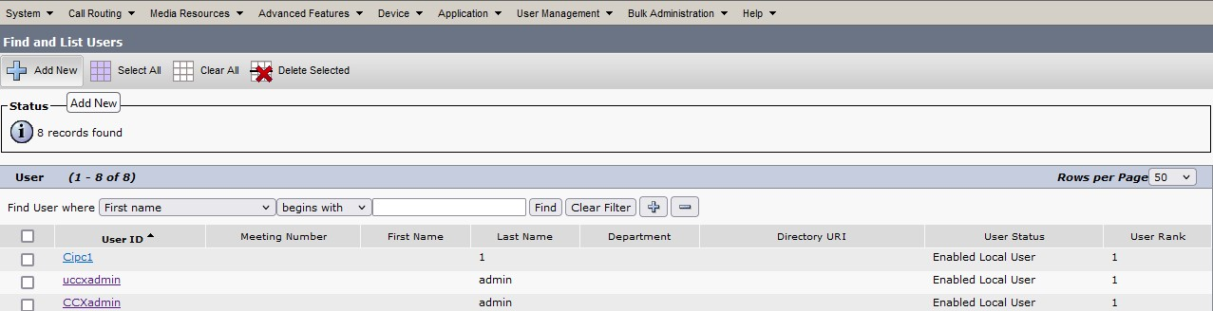
إضافة المستخدم النهائي
User Management → End user
Click Add New

Slide 37
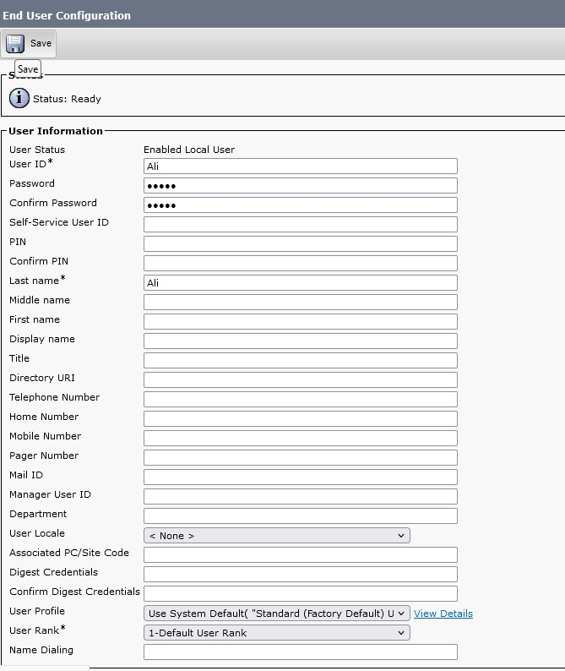
إضافة المستخدم النهائي
Enter below Details
User ID
Name: first and last name
Password
Click save button

Slide 38
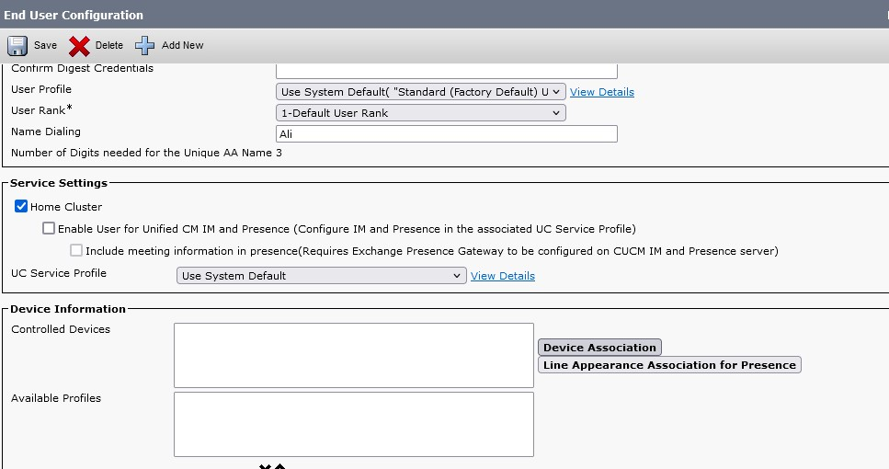
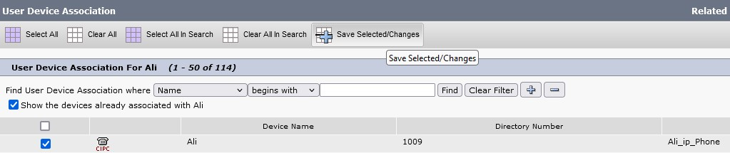
إضافة المستخدم النهائي - اقتران الجهاز
Click Device Association
Select Device

Slide 39
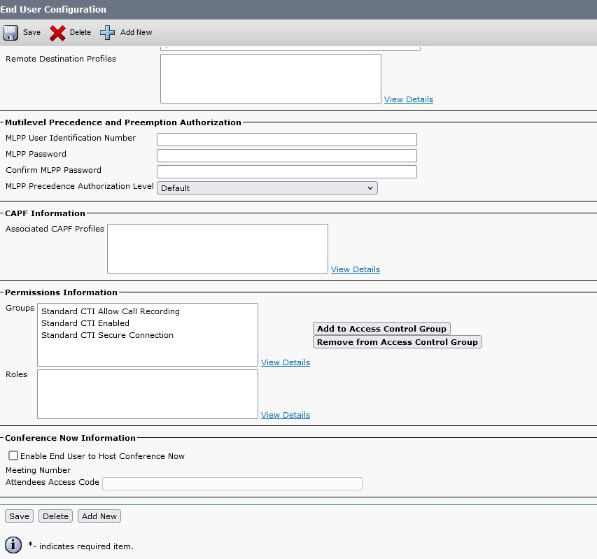
إضافة مستخدم نهائي - مجموعة التحكم في المكالمات
Call Control Group

Slide 40
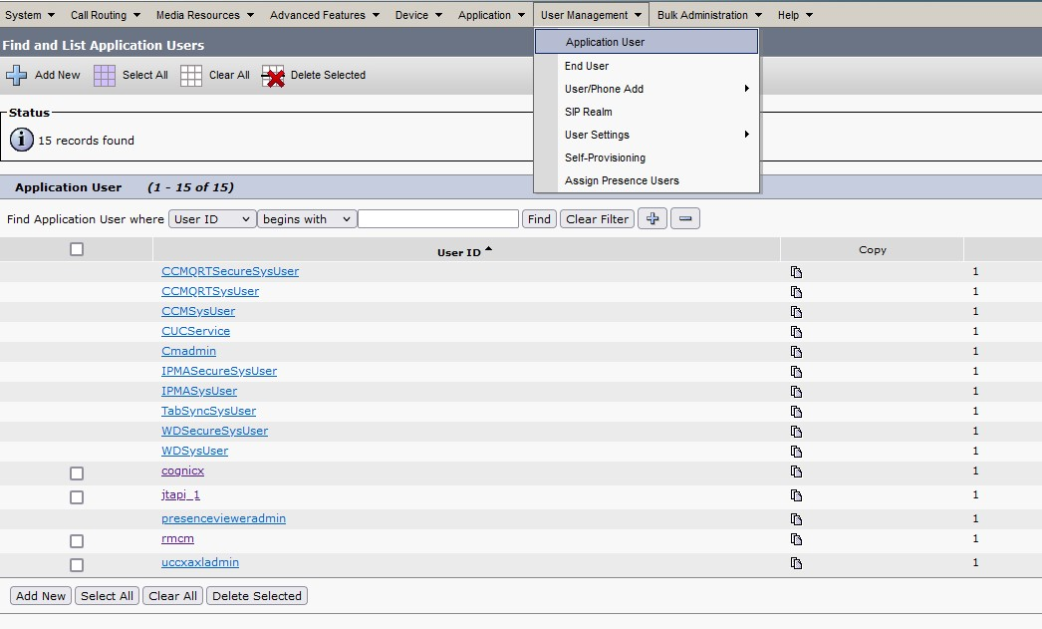
إضافة مستخدم نهائي - مستخدم التطبيق
Add the user to application user select rmcm and jtapi user

Slide 41
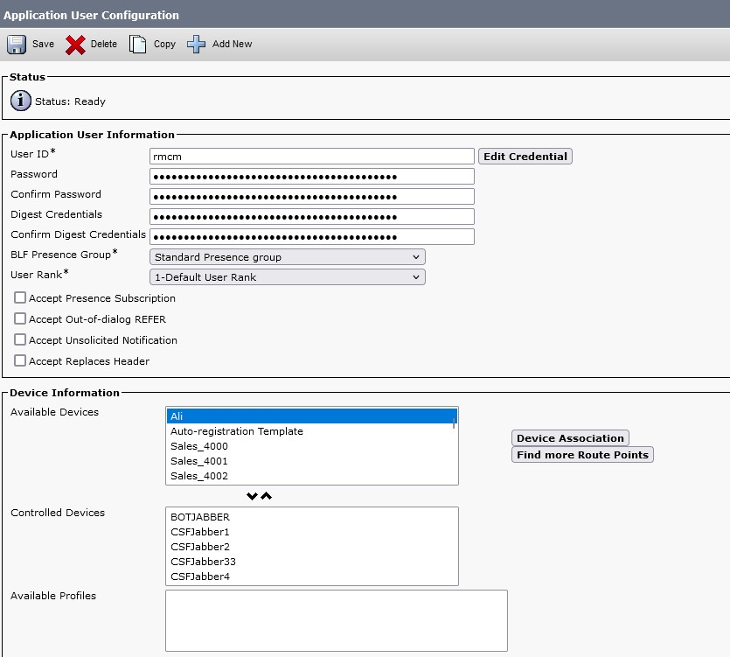
إضافة مستخدم نهائي - مستخدم التطبيق
Add Device from available Devices from “Controlled Devices”

Slide 42
UCCX تكوين المستخدم النهائي -

Slide 43
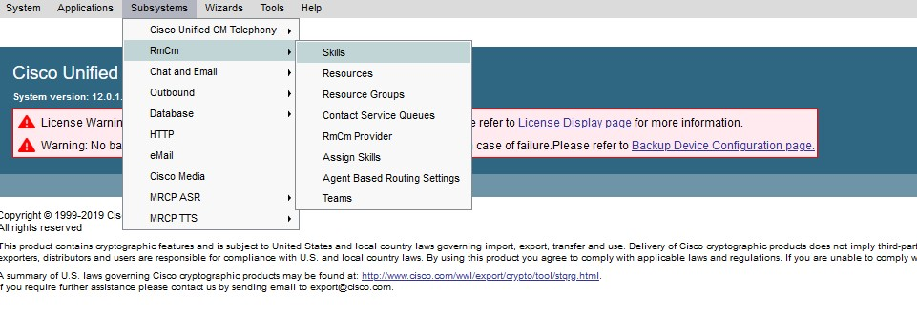
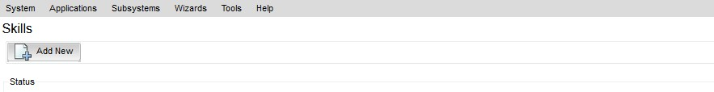
أضف مهارة
Login to UCCX
Subsystems→RmCm→Skills
Add New

Slide 44
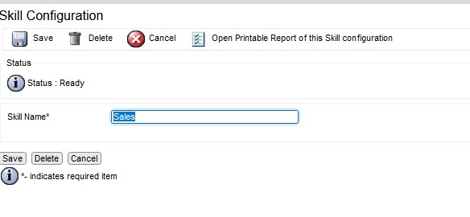
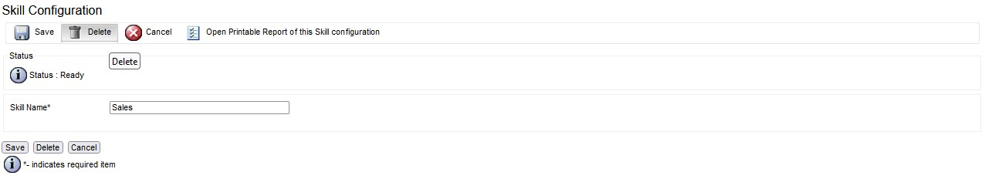
إضافة / إزالة المهارة
Add Skill name and Update
Click Delete To remove skill

Slide 45
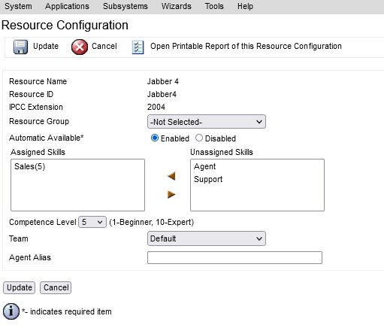
أضف مهارة إلى المورد
Select Skill and Assign Skill

Slide 46
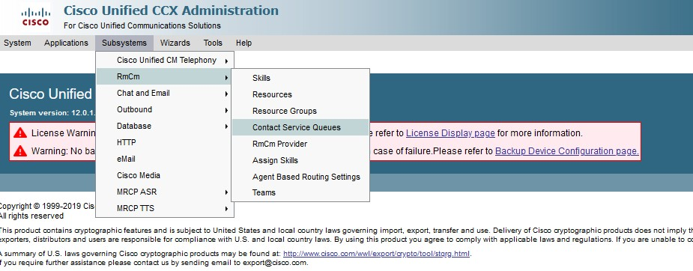
CSQ أضف
Subsystem→RmCm→Contact Service Queues
Assign Skill

Slide 47
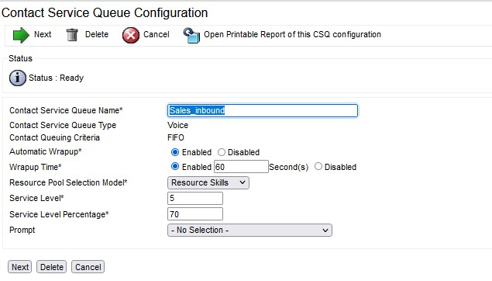
تكوين قائمة انتظار خدمة الاتصال - CSQ إضافة
Subsystem → RmCm→ Contact Service Queues

Slide 48
CUIC تقارير

Slide 49
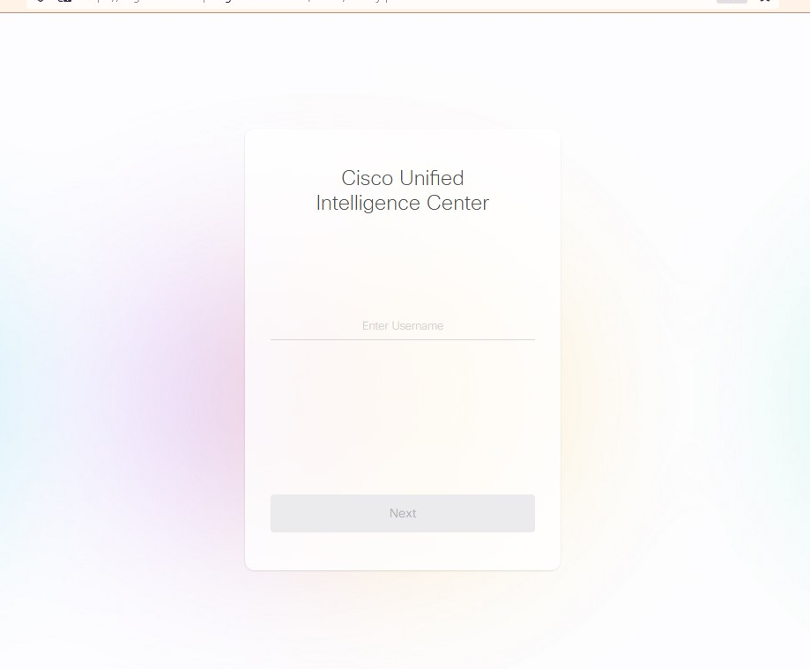
كيفية تسجيل الدخول
CUIC Login URL: https://<FQDN>:<PORT NUMBER: 8444>/cuic

Slide 50
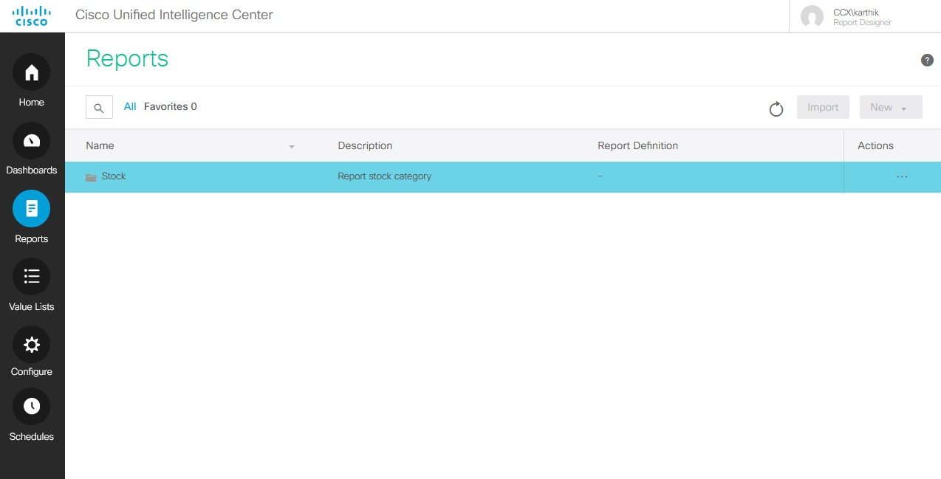
التقارير - CUIC
Choose “Reports” option

Slide 51
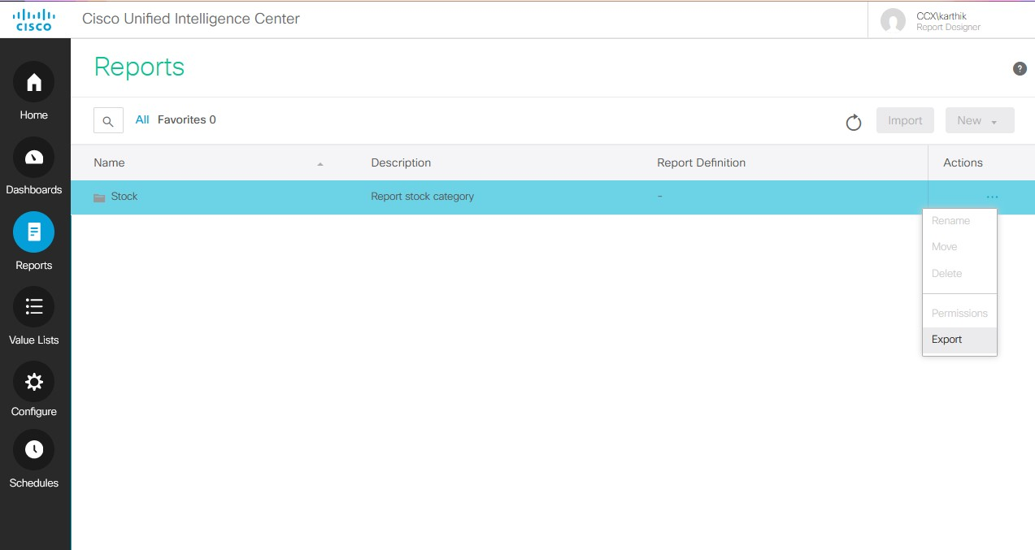
تصدير التقارير - CUIC
Select stock and choose Export for exporting complete reports.

Slide 52
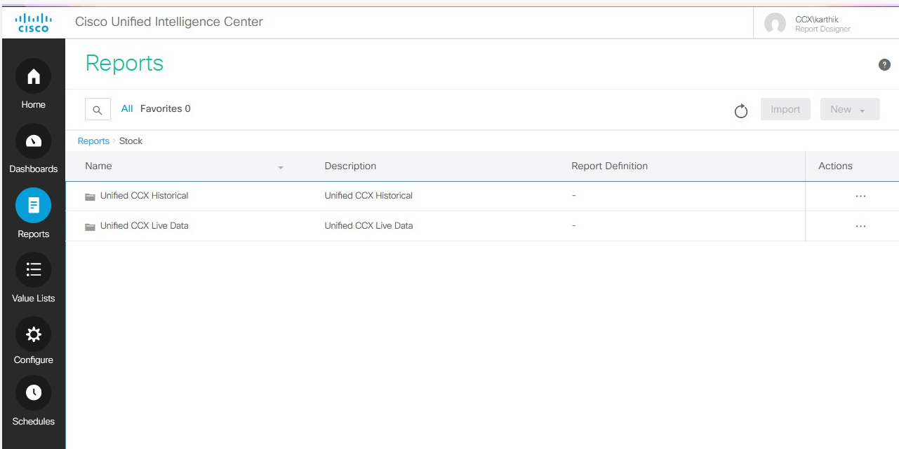
تقارير – خيارات - CUIC
Click on Stock to view following 2 options
Unified CCX Historical
Unified CCX Live Data

Slide 53
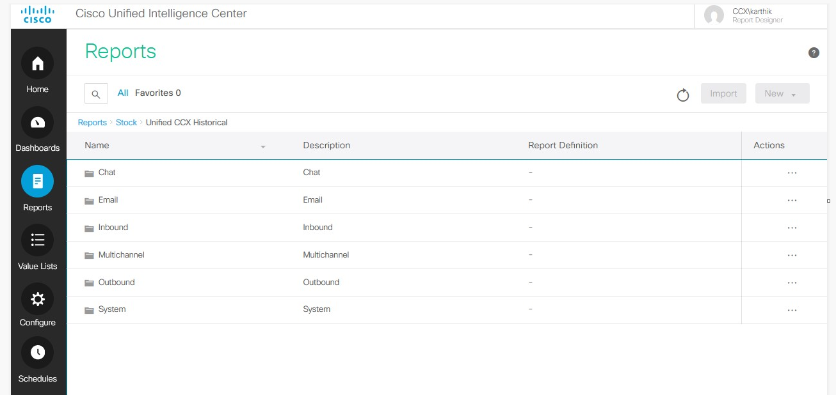
تقارير البيانات التاريخية - CUIC
Historical Report have below options
-> Chat, Email, Inbound, Multichannel, Outbound, System

Slide 54
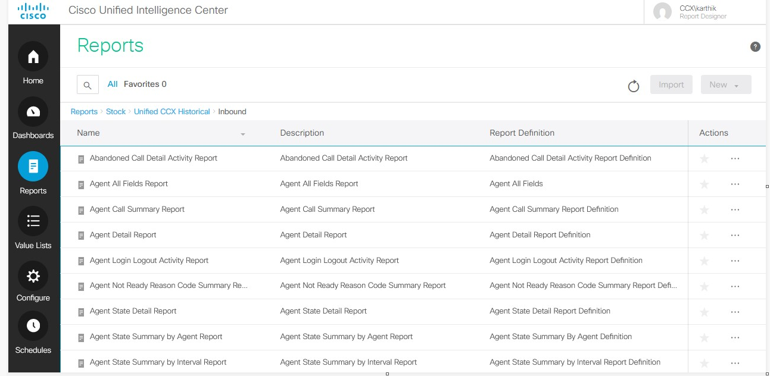
تقارير البيانات التاريخية –الداخل - CUIC
Historical Report have below options
-> Inbound→ choose the report→ Export in Actions

Slide 55
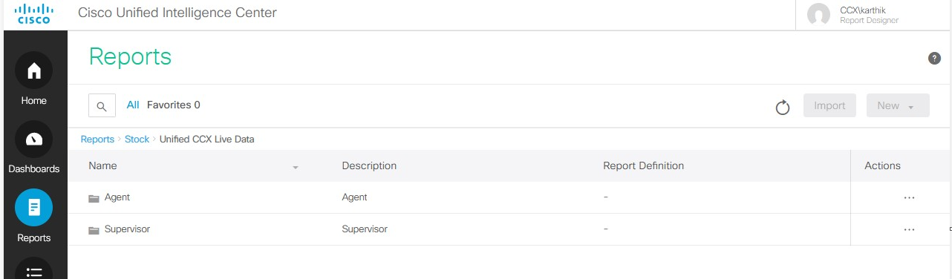
تقارير البيانات الحية - CUIC
Live Data Report have below options
Agent
Supervisor

Slide 56
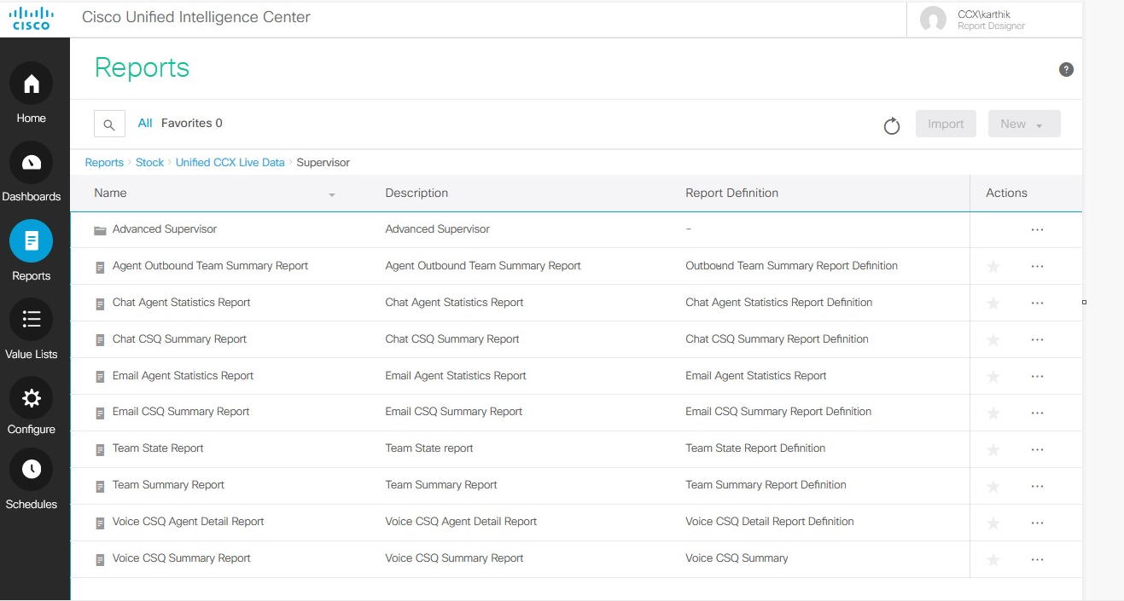
تقارير البيانات الحية – مشرف - CUIC
Cisco CCX Live Data → Supervisor
Choose the required report
Click Export in Actions

Slide 57
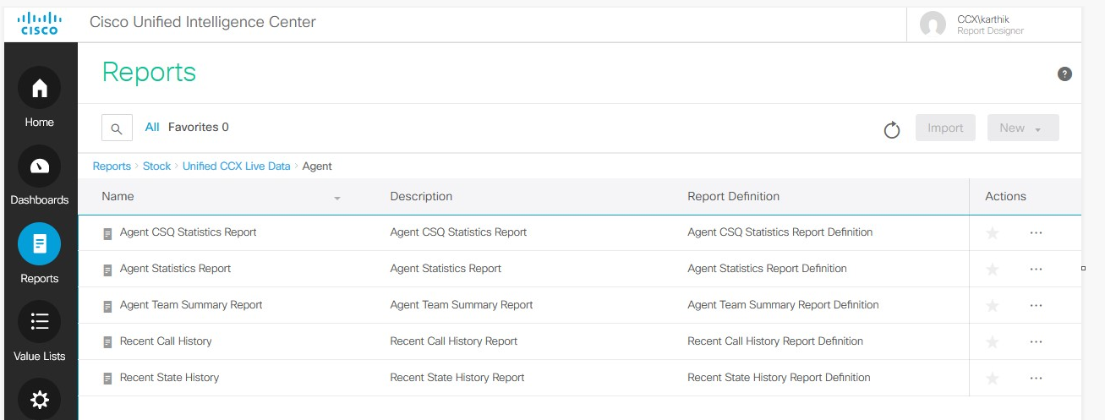
تقارير البيانات الحية – وكيل - CUIC
Cisco CCX Live Data → Agent
Choose the required report
Click Export in Actions

Slide 58
شكرا لك!

